Slide 1





TERRAGNI CONSULTING (P) LTD PRIVATE AND CONFIDENTIAL

Slide 2

Premium Banking
Customer Engagement For
Confidentiality
All of the information included in the Approach Note/Proposal (herein referred to as “Proposal ”) has been prepared for your sole, confidential and exclusive benefit and use.
The Proposal, nor any portion or portions thereof, are intended to benefit any other person. If you directly or indirectly allow or cause the Proposal or any portion or portions thereof to be disclosed to any third party, or providing a copy or any portion or portions of any document or documents, you agree to indemnify, defend, and hold Terragni Consulting (p) Ltd. harmless for any claims or actions based on the Proposal or any information contained therein, brought by the third party and/or any other party.
Copyright
All content included in this document, including the text, graphics, PDF files, links, logos, button icons, images, digital downloads, data compilations, and software is the property of Terragni Consulting (p) Ltd. and is protected by India’s copyright laws.
The compilation of all content in this document is the exclusive property of Terragni Consulting (p) Ltd.
TERRAGNI CONSULTING (P) LTD PRIVATE AND CONFIDENTIAL

Slide 3
Contents.
Objective
04
Scope
06
The Competition
62
The Context
13
Experiential Segmentation
89
Insights - Headlines
14
Relationship Custodian
94
Expectation – Experience Gap
24
The White Glove
95
Financial Transactions
29
Service Recovery
Helps Me Grow My Money
36
Perceived Friction
Enhance My Lifestyle
45
Suggested Implementation Approach
The Relationship Manager
55
TERRAGNI CONSULTING (P) LTD PRIVATE AND CONFIDENTIAL
Notes:
Content items hidden – Service Recovery, Perceived Friction, Suggested Implementation

Slide 4



Objective
Drive higher customer engagement for Celesta customers and potential customers through
Contextual differentiation from
the competition and within the existing overall customer segment
Using signature differentiated experiences
TERRAGNI CONSULTING (P) LTD PRIVATE AND CONFIDENTIAL

Slide 5


The Business Shift.
The Behaviour Shift.
To be perceived as a “Uniquely Different”
By existing customers
By potential customers
Higher word-of-mouth (to influence potential customers)
Higher program utilization by existing customers
TERRAGNI CONSULTING (P) LTD PRIVATE AND CONFIDENTIAL
Notes:
Context is key,
Example – A young entrepreneur vs. youngster second gen managing family business – Could be the same business, same RV; but their decision making & approach to finances will be different
Consequently the experiences they seek will be different
Autonomy in decision making, decision influencers, experiences – own as well as observed will all impact how they approach finance an

Slide 6

Scope
43,256
165+
PAN INDIA
WIDESPAN ASSESSMENT
DEPTH
CONVERSATIONS
43,256
14~2~5
CONVERSATION
PURPOSIVELY SAMPLED
6
TERRAGNI CONSULTING (P) LTD PRIVATE AND CONFIDENTIAL

Slide 7

The Context
Lens through which customers view the engagement
THE ENGAGEMENT
PILLARS
&
HIERARCHY OF EXPECTATIONS

Slide 8

The Engagement Pillars
These are the dimensions of customer engagement in the context of Premium Banking & affluent customers
Functional
Identity
Social
Emotional
The core offering of banking and financial services
How do others perceive me when they see me using this brand, how do I feel?
Do other people who use this brand belong to the “tribe” I aspire to
The core emotions- Valence and Activation
TERRAGNI CONSULTING (P) LTD PRIVATE AND CONFIDENTIAL
Notes:
Functional
Saves Time, Reduces Cost – Removed
Emotional
Invested – in me

Slide 9
The Engagement Pillars
The attributes of the dimensions of customer engagement in the context of Premium Banking & affluent customers
Functional
Identity
Social
Emotional
Friction Free
Badge Value
Affiliation
Safe
Simplifies
Pride
Prestige
Control
Peace of mind
Helps me enhance my lifestyle
Aspirational
Empowered
Helps me grow my money
Exclusive
Valued
TERRAGNI CONSULTING (P) LTD PRIVATE AND CONFIDENTIAL
Notes:
Functional
Saves Time, Reduces Cost – Removed
Emotional
Invested – in me

Slide 10
PREMIUM BANKING experience
Hierarchy of Expectations.
FUNCTIONAL EXPECTATIONS
EXPERIENTIAL EXPECTATIONS
Help me grow my money
contextual. consistent. transparent
Enhance my lifestyle
Personalized prestige. Contextual exclusivity.
Financial transactions
safe. secure. friction-free
TERRAGNI CONSULTING (P) LTD PRIVATE AND CONFIDENTIAL

Slide 11


PREMIUM BANKING experience – CATEGORY LEVEL
FUNCTIONAL EXPECTATIONS
Hierarchy of Expectations.
Help me grow my money
contextual. consistent. transparent
Today
Financial transactions
safe. secure. friction-free
Customer expectations have evolved
Premium Banking no longer seen merely as a means of “stress-free” banking
Customers expect a contextual, tangible contribution to their financial goals
Circa 2020
11
n= 622
TERRAGNI CONSULTING (P) LTD PRIVATE AND CONFIDENTIAL

Slide 12

PREMIUM BANKING experience – CATEGORY LEVEL
EXPERIENTIAL EXPECTATIONS
Hierarchy of Expectations.
Enhance my lifestyle
Personalized prestige. Contextual exclusivity.
Prestige and Exclusivity continue to be important dimensions of experiential differentiation
12
TERRAGNI CONSULTING (P) LTD PRIVATE AND CONFIDENTIAL
n= 622

Slide 13
The Context
in which the future of Celesta should be viewed
Customers’ expectations from “Premium Programs” are multi-layered
They span from functional needs to prestige needs and emotional salience
Functional needs are hygiene and table-stakes –
expectations are not differentiated
Prestige & Emotional Salience drive implicit engagement & emotional associations – expectations are well differentiated
13
TERRAGNI CONSULTING (P) LTD PRIVATE AND CONFIDENTIAL

Slide 14
The Insights
How customers perceive Celesta
THE ENGAGEMENT
PILLARS
&
HIERARCHY OF EXPECTATIONS

Slide 15
The Headline
The situation in a nutshell
TERRAGNI CONSULTING (P) LTD PRIVATE AND CONFIDENTIAL

Slide 16
The Celesta Customer
16
The current Celesta customer is predominantly Non-Resident men aged 45 years & above with a conservative approach towards investments & wealth.
They primarily seek ease of remittance and assurance of support in managing the remittance.
Functionally, Celesta delivers this in hassle-free manner. 24X7 RM availability & digital assets (FedNet & FedMobile) with friction free remittance journeys are key drivers of this experience.
Gender
Age
TERRAGNI CONSULTING (P) LTD PRIVATE AND CONFIDENTIAL

Slide 17
17
Customers Expect Celesta to Evolve
However, as other banks grow their premium banking offerings, these customers are beginning to seek additional experiential services.
95% of respondents have indicated that Celesta should evolve its customer engagement strategies!
TERRAGNI CONSULTING (P) LTD PRIVATE AND CONFIDENTIAL

Slide 18
PREMIUM BANKING experience - CELESTA
Hierarchy of Expectations.
FUNCTIONAL EXPECTATIONS
EXPERIENTIAL EXPECTATIONS
n= 165
TERRAGNI CONSULTING (P) LTD PRIVATE AND CONFIDENTIAL
n= 165
Notes:
Dedicated Relationship Manager + Advanced Digital Banking Solutions+ Streamlined Banking Services + Enhanced Security Features+ Family Banking Services = Quick hassle-free banking -39%
Goal-Oriented Investment Management + Tailored Wealth Management Solutions + Personalized Financial Wellness Coaching + Exclusive Access to Financial Workshops + Tax Advisory and Planning + Tailored Estate Management Services= Financial well-being guidance and advice- 46%
Business Financial Advisory Services++ Philanthropic Financial Planning = Financial planning for business- 14%
All data around 622 respondent.

Slide 19
What Celesta delivers today
FUNCTIONAL EXPECTATIONS
While 53% customers seek financial guidance and advice, only 22% see Celesta playing this role for them
Having 3 RM types (PRM, IRM, Equirus RM) creates friction and is a barrier
n= 165

Slide 20
20
What Celesta delivers today
premium banking services - experience
Regular statements and reports is the most used feature
On an average 60-70% Celesta respondents have experienced premium banking services.
Driving better utilization of services is a low-hanging fruit!
20
TERRAGNI CONSULTING (P) LTD PRIVATE AND CONFIDENTIAL
n= 165
Notes:
This is same matrix question Who would you consider as the best performing premium banking program on the following parameters? for premium banking services
All data from federal competitor brands(Kotak= 125,HDFC=125,AXIS=125) and federal customer + fed competitors addition i.e= (165) respondent.

Slide 21
What Celesta delivers today
EXPERIENTIAL EXPECTATIONS
Less than 50% Celesta respondents consider the non-banking lifestyle benefits to be best in class
~30% prefer competition programs
n= 165
Notes:
Convert this to vertical graph-Done

Slide 22

22
EMOTION INSIGHTS
Emotions that drive engagement for CELESTA TODAY
Emotional associations exhibited by current Celesta customers
Customers see “Prestige”, “Assurance”, “Innovative” & “Relevant” as the defining attributes for Celesta.
Celesta overall is also not seen as “Stressful”.
Customers do not see Exclusivity, Financial growth, Convenience as strong attributes for Celesta.
As a result, they do not perceive Celesta to be playing a role in their “Life Goals”.
This combined with a negative association with personalization also leads the customers to perceive Celesta as moderately “Intrusive”
For the association strength table – please see slide <> in annexures
TERRAGNI CONSULTING (P) LTD PRIVATE AND CONFIDENTIAL
n= 165
Notes:
Put a brain
Long standing history & the personal connect drive a strong sense of Assurance
“Relative” affluence drives a sense of prestige
Digital forwardness of touchpoints & process drives a perception of Innovation & also builds higher relevance for the current customer
Perceived lack of alignment with customers’ contexts , high perceived & cognitive friction of engaging with “wealth management” and lifestyle benefits drives the weak associations with “Exclusivity”, “confidence”

Slide 23
Strength of word-of-mouth
“Word-of-mouth” is strong influencer of “choice” in the affluent category
Current Celesta Customer Engagement, though robust, is driven by transactional attributes.
Absence of “stories” means little social proof
Customer acquisition thus relies on a high cost, high effort “Push” against competition
Sales Effort – 55%
Federal Bank relationship manager– 36%
Information received during a visit to a bank branch.– 19%
Marketing & Advertising– 31%
Information found on the Celesta Federal Bank website-21% Through online or offline advertisements (TV, print, etc.).-10%
Word of Mouth & Referrals-13%
Through friends or family recommendations.-9%
Recommendations from financial advisors or consultants.-4%
23
n= 165
TERRAGNI CONSULTING (P) LTD PRIVATE AND CONFIDENTIAL

Slide 24
24
Summary
The current Celesta customer does not seek the program for their investment planning & management needs. The premium banking services are perceived to be lacking on Life Goals relevance and consequently high on friction.
Celesta lifestyle benefits are similarly perceived to be limited and difficult to avail. The concierge service understanding is restricted to “Pick & drop” facilities. This and the Lounge are the most utilized services. While these are appreciated, early signs of disengagement are beginning to show.
As a result, experientially, Celesta is not perceived to deliver on elements of Identity & Social Dimensions.
This results in a low “word-of-mouth” making the “push” against competition an uphill battle!
TERRAGNI CONSULTING (P) LTD PRIVATE AND CONFIDENTIAL

Slide 25
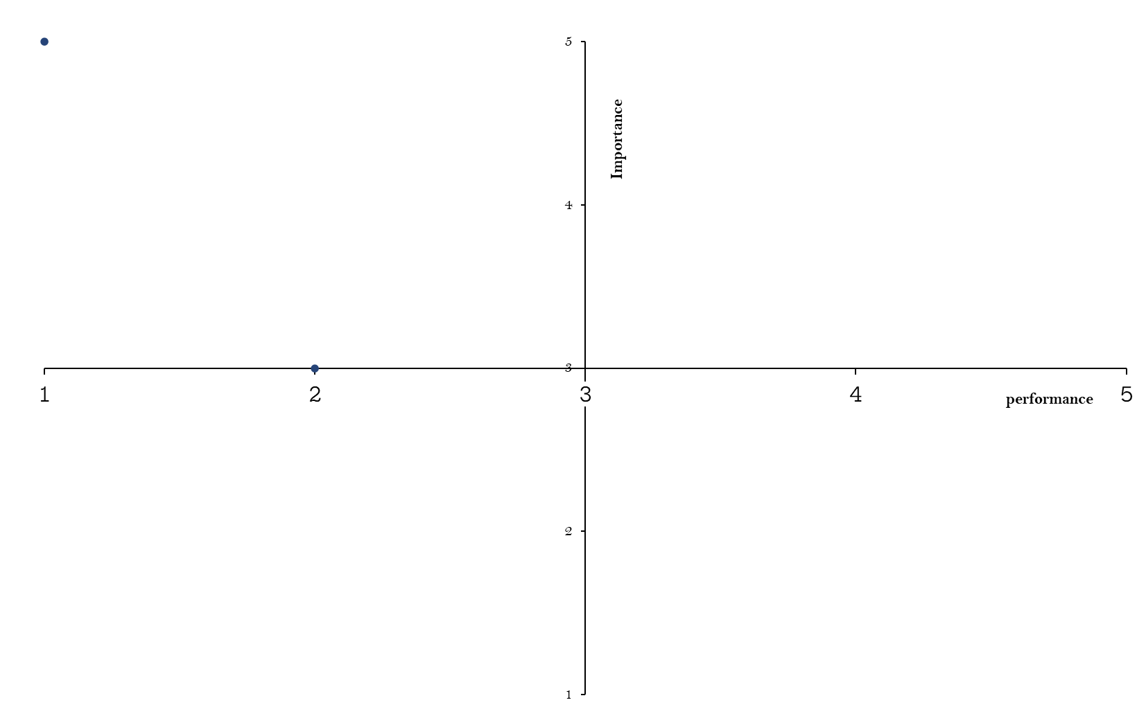
Terragni Experience Grids
prioritized implementation areas
2
1
The grid plots customer experience drivers on two dimensions:
  The relative impact of an experienced driver on overall customer attitude and behavior, customer perception of the brand’s performance on that experienced driver.
  It gives brands a strategic framework within which to debate and evolve an action-direction for each experience driver in their customers’ journey with them.
High Importance
Poor Experience
High Importance
Good Experience
Immediate priority action areas
Strength areas that should be leveraged to drive deeper engagements
3
4
Lower Importance
Poor Experience
Lower Importance
Good Experience
Areas where effort & resources are being invested but not only does the customer not see them as value-add; on the contrary they are detracting from the experience
Areas where effort & resources are being invested but the customer does not really see them as value-add
25
TERRAGNI CONSULTING (P) LTD PRIVATE AND CONFIDENTIAL

Slide 26
WHAT WE BELIEVE
Attributes | Importance | Performance
Remittance arrangements | 2 | 2
RM | 2 | 1
Private/ Relationship banking
Onboarding experience
Eligibility criteria
Credit card | 1.5 | 0
Debit Card | 1 | 1
Banking Channel
Concierge services
Wealth Management | 1 | 2
Dedicated Customer Care( Celesta Desk)
Product features
Infrastructure in the branches
Customised offers | 0.5 | 0.5
Personalized/Rewards point
Doorstep banking | 0 | 1.5
Concessional rates | 0 | 1
Complimentory Insurance | -0.5 | 2
High Cash intensive transactions (higher withdrawal limits etc) | -2 | -2
Lounge program | -2 | 2
2
1
3
4
TERRAGNI CONSULTING (P) LTD PRIVATE AND CONFIDENTIAL
26
Notes:
This slide is based on how celesta team has rated them selves
Can you create a “Customer” version of this, based on assessment responses?

Slide 27
WHAT CUSTOMERS PERCEIVE
Attributes | Importance | Performance
Remittance arrangements | 2 | 1
Banking Channel | 2 | 0
RM | 2 | 2
Wealth Management | 2 | -1
Dedicated Customer Care( Celesta Desk)
Product features
Infrastructure in the branches
Credit card
Concessional rates
Debit Card
Customised offers | 2 | -2
Personalized/Rewards point
Concierge services | 1 | 0
Private/ Relationship banking
Onboarding experience | 1 | -1
Eligibility criteria
Lounge program
Complimentory Insurance | 0.5 | -1
High Cash intensive transactions (higher withdrawal limits etc) | 0 | 0.5
Doorstep banking | -2 | -1
2
1
3
4
27
TERRAGNI CONSULTING (P) LTD PRIVATE AND CONFIDENTIAL
Notes:
This slide is based on how “Customer” perceives celesta

Slide 28
The Headline
Expectation – Experience Gap
18
TERRAGNI CONSULTING (P) LTD PRIVATE AND CONFIDENTIAL

Slide 29
Expectation experience gap
What FEDERAL believes they provide (Insights from internal setting sail – kickoff conversations)
BLUE : ATTRIBUTES THAT FEDERAL BELIEVES CELESTA DELIVERS
GREY: ATTRIBUTES THAT FEDERAL BELIEVES CELESTA DOES NOT DELIVER ON
Functional
Identity
Social
Emotional
Friction Free
Badge Value
Affiliation
Safe
Simplifies
Pride
Prestige
Control
Peace of mind
Helps me enhance my lifestyle
Aspirational
Empowered
Helps me grow my money
Exclusive
Valued
21
TERRAGNI CONSULTING (P) LTD PRIVATE AND CONFIDENTIAL

Slide 30
30
Expectation experience gap
what customer perceives
BLUE : ATTRIBUTES THAT customers BELIEVES CELESTA DELIVERS
BLUE : ATTRIBUTES THAT customers BELIEVES CELESTA does not satisfactorily DELIVEr
GREY: ATTRIBUTES THAT customers BELIEVES CELESTA DOES NOT associate with celesta at all
Functional
Identity
Social
Emotional
Friction Free
Badge Value
Affiliation
Safe
Simplifies
Pride - Home
Prestige
Control
Peace of mind
Helps me enhance my lifestyle
Aspirational
Empowered
Helps me grow my money
Exclusive
Valued
TERRAGNI CONSULTING (P) LTD PRIVATE AND CONFIDENTIAL

Slide 31

The Specifics
FINANCIAL TRANSACTIONS . HELP ME GROW MY MONEY . ENHANCE MY LIFESTYLE
31
TERRAGNI CONSULTING (P) LTD PRIVATE AND CONFIDENTIAL

Slide 32


CELESTA
CURRENT CUSTOMER : CURRENT NEEDS
Financial Transactions
safe . secure . friction free
32
TERRAGNI CONSULTING (P) LTD PRIVATE AND CONFIDENTIAL

Slide 33
FINANCIAL TRANSACTIONS
Friction reduction is an opportunity area
33
Safe. Secure. Friction Free
IN A NUTSHELL
Digital touchpoints deliver control and empowerment for basic financial transactions (remittances, balance enquiry and such)
“Relationship Manager” is promptly available for support where digital touchpoints fall short
While Celesta respondents are happy with their experience of the RM & Digital Touchpoints, ~40% respondents indicate a dissatisfaction with error resolution delays & Call centre support
This is indicative of an over-reliance on “RM” as primary agent of experience delivery; an approach difficult to scale
TERRAGNI CONSULTING (P) LTD PRIVATE AND CONFIDENTIAL
Notes:
Removed content
A breakdown on the basic expectation of friction free financial transactions disengages the customer from the entire program

Slide 34
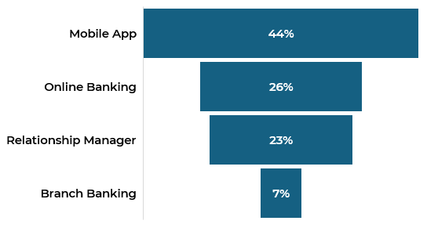
FINANCIAL TRANSACTIONS
Friction reduction is an opportunity area
Safe. Secure. Friction Free
Strong preference for “Self Service” transactions
Federal digital touchpoints are rated better than competition
TOUCHPOINT PREFERENCE
Digital self-service
34
n= 165
TERRAGNI CONSULTING (P) LTD PRIVATE AND CONFIDENTIAL
n= 165

Slide 35
FINANCIAL TRANSACTIONS
Friction reduction is an opportunity area
Safe. Secure. Friction Free
When the digital touchpoints fall short, customers reach out to the RM or the Branch.
Relationship manager
Branch
35
n= 165
TERRAGNI CONSULTING (P) LTD PRIVATE AND CONFIDENTIAL
n= 165
Notes:
For this slide I took options from Who would you consider as the best performing premium banking program on the following parameters? Transaction ease, support questions and combine there options as below:
For Branch= Ease of interaction/transaction & Ability to provide relevant support.
For RM= Ease of interaction & Availability & Ability to sort most issues.
For service recovery= Resolving queries and doubts & Support from call centre & Correcting errors,mistakes & delays.
This is matrix questions & data for Federal is from fed customer + fed competitors

Slide 36
FINANCIAL TRANSACTIONS
Friction reduction is an opportunity area
Safe. Secure. Friction Free
While respondents perceive service recovery to be satisfactory, there is headroom for improvement in Call Centre performance and in addressing errors & delays.
SERVICE RECOVERY
“During this PIS delays and everything, they were not responding properly”
36
n= 165
TERRAGNI CONSULTING (P) LTD PRIVATE AND CONFIDENTIAL
Notes:
Need verbatims here that talk about customer service issues via contact centre. Ask Hrishikesh to support-
I have added verbatims as per his insights file & as per my understanding, please check.

Slide 37
FINANCIAL TRANSACTIONS
Friction reduction is an opportunity area
37
Safe. Secure. Friction Free
"I use mobile banking more than the web version"
“Especially with net banking, certain PoS, It sometimes takes so long and then it times out or it says server not available”
Female
Male
"Very frequently I'm using that mobile app, which is excellent. I would say that it is second to none. Most of the things get done through FedMobile. 90% of my transactions Have been through FedMobile."
“You have an upgraded mobile app. For FDs, It was automatic renewal always, but now it is an upgraded app”
Male, 50-65
Female
TERRAGNI CONSULTING (P) LTD PRIVATE AND CONFIDENTIAL

Slide 38
FINANCIAL TRANSACTIONS
Friction reduction is an opportunity area
38
Safe. Secure. Friction Free
“You need to access things quick and you need to know at any point in time what's happening, right? So, that accessibility matters. So, that facility of tracking was not so great in terms of online platforms”
“I cannot make any one-time mandate for purchasing any mutual fund with any other AMCs”
Female
Male, 40-50
“With net banking, sometimes you find that certain PoS, I'm not saying everywhere, but certain PoS, It sometimes takes so long and then it times out or it says server not available, things like that.”
Male,
TERRAGNI CONSULTING (P) LTD PRIVATE AND CONFIDENTIAL

Slide 39
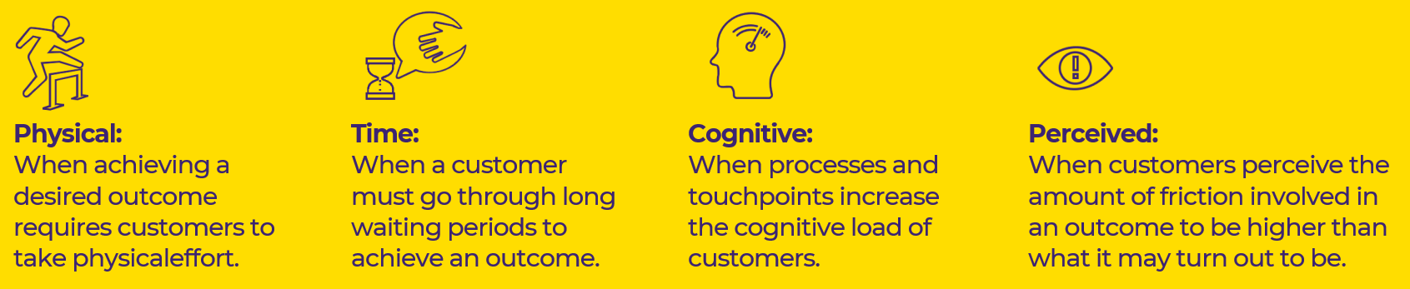
FINANCIAL TRANSACTIONS
39
Safe. Secure. Friction Free
Federal Bank presents little to negligible Physical and Time friction to its customers
Cognitive Friction experienced by the customers is attenuated largely by the personal attention from the RM teams
Customers experience high Perceived Friction in their “Premium Banking” journeys
TERRAGNI CONSULTING (P) LTD PRIVATE AND CONFIDENTIAL

Slide 40

CELESTA
CURRENT CUSTOMER : GROWING NEEDS
Help me grow
my money
contextual . consistent . transparent
TERRAGNI CONSULTING (P) LTD PRIVATE AND CONFIDENTIAL

Slide 41
Contextual alignment is an opportunity area
HELP ME GROW MY MONEY
CONTEXTUAL . CONSISTENT . TRANSPARENT
IN A NUTSHELL
Celesta respondents do not perceive Celesta to be an option for their wealth management & investment planning requirements
Lack of options, advice that is not aligned to their context & goals drives a high sense of friction when engaging with the premium banking features
Having to engage with a 3rd party (Equirus) adds to the perception of friction
Consequently, Celesta is perceived to fall short on investment advisory and wealth management features.
41
TERRAGNI CONSULTING (P) LTD PRIVATE AND CONFIDENTIAL

Slide 42
Contextual alignment is an opportunity area
42
HELP ME GROW MY MONEY
CONTEXTUAL . CONSISTENT . TRANSPARENT
Emotional affinity of premium banking services
For the current Celesta customer base most salient features, of a premium banking features are :
Reduced transaction fees, Investment wealth advisory
On the other hand, Current account servicing, Doorstep banking, Foreign Exchange has the weakest salience
For salience strength tables please see slide <<>> in annexures
TERRAGNI CONSULTING (P) LTD PRIVATE AND CONFIDENTIAL
n= 165

Slide 43
Contextual alignment is an opportunity area
HELP ME GROW MY MONEY
CONTEXTUAL . CONSISTENT . TRANSPARENT
premium banking services - experience
60-70% Celesta respondents have experienced premium banking services.
Of those who have experienced premium banking services, nearly 1/3rd perceive the competition to be better
43
TERRAGNI CONSULTING (P) LTD PRIVATE AND CONFIDENTIAL
n= 165
Notes:
This is same matrix question Who would you consider as the best performing premium banking program on the following parameters? for premium banking services
All data from federal competitor brands(Kotak= 125,HDFC=125,AXIS=125) and federal customer + fed competitors addition i.e= (165) respondent.

Slide 44
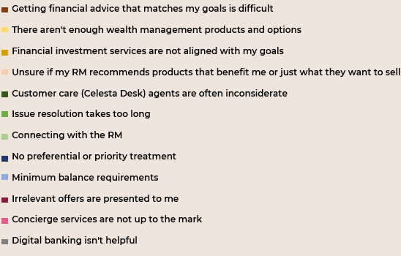
Contextual alignment is an opportunity area
HELP ME GROW MY MONEY
CONTEXTUAL . CONSISTENT . TRANSPARENT
premium banking services - experience
At 40%, dissatisfaction with investment advisory services is the key challenge area for Celesta respondents
44
TERRAGNI CONSULTING (P) LTD PRIVATE AND CONFIDENTIAL
n= 165
Notes:
This is same matrix question Who would you consider as the best performing premium banking program on the following parameters? for premium banking services
All data from federal competitor brands(Kotak= 125,HDFC=125,AXIS=125) and federal customer + fed competitors addition i.e= (165) respondent.

Slide 45
Contextual alignment is an opportunity area
HELP ME GROW MY MONEY
CONTEXTUAL . CONSISTENT . TRANSPARENT
premium banking services – experience WOMEN RESPONDENTS
Financial products, options & advisory are the main areas of disengagement
Relevance, transparency and effort are the primary barriers
Women customers exhibit higher dissatisfaction levels with the RM
The financial advice isn't detailed enough
The financial products don't fit my needs
My Relationship Manager (RM) doesn't understand my challenges
Lifestyle benefits are not tailored to my needs as a woman
45
TERRAGNI CONSULTING (P) LTD PRIVATE AND CONFIDENTIAL
n= 42
Notes:
For all respondent graph I took What challenges do you face while banking with Federal Bank? Only male federal customers from Fed customer fed competitors , this is multi select question so count is around 262 for (Advisory, service, & offers) for 165 unique respondent.
As a successful woman, what problems do you face with your premium banking at Federal Bank? around 80 federal women respondent-

Slide 46
“The moment I remit funds to my account basis that money I'm remitting there would be automatic suggestion coming in to tell me, I mean you know, this could work for you. Something like that. Or they call it contextual banking”
"FD is also there, a little bit of concern. I think it has started changing now. When you make an FD, there should be an option to auto close it. That option was not coming. I have been telling Neha this for last 2 years, I said, See I have to write to you every time when my FD is maturing."
“Budget announced, they changed the taxing scheme. early this 10% it has become 12.5-13%, including all other things. Even after that actually there were detecting LTCG and all with the old. I've been asking the bank why this is happening. Almost 3-4 months they've been doing”
Female
Male
Male, 40-50
Biases at Play: Ego Depletion, Empathy Gap
46
TERRAGNI CONSULTING (P) LTD PRIVATE AND CONFIDENTIAL
Notes:
Ask Hrishikesh to give you verbatims around the hesitation to use the equirus Investment manager services- I have added as per my understanding.

Slide 47

CELESTA
CURRENT CUSTOMER : GROWING NEEDS
Enhance my
lifestyle
personalized prestige . personalized convenience
47
TERRAGNI CONSULTING (P) LTD PRIVATE AND CONFIDENTIAL

Slide 48
ENHANCE MY LIFESTYLE
Personalization is an opportunity area
PERSONALIZED CONVENIENCE. PERSONALIZED PRESTIGE
IN A NUTSHELL
Concierge services are mainly understood as the “pick-up & drop” facilities.
Exposure to Lifestyle Benefits is limited to “Lounge” & “Pick-up drop” facilities . The lounge access facility is perceived to be high on friction especially when the “family” is travelling . The “Pick-up drop” facility is seen as a gesture from the RM & not a structured benefit
Significant percentage of respondents find the card benefits & offers irrelevant or difficult to utilize
Overall, nearly 50% of the respondents who have experienced Celesta lifestyle benefits, rate competition brands to be better
48
TERRAGNI CONSULTING (P) LTD PRIVATE AND CONFIDENTIAL

Slide 49
Personalization is an opportunity area
ENHANCE MY LIFESTYLE
PERSONALIZED CONVENIENCE. PERSONALIZED PRESTIGE
Emotional affinity to Lifestyle benefits
For the current Celesta customer base most salient Lifestyle Benefits features are those that provide : Personalized luxury & , Exclusive events
On the other hand, Concierge, Philanthropy , Exclusive digital content have the weakest salience
For salience strength tables please see slide <<>> in annexures
49
TERRAGNI CONSULTING (P) LTD PRIVATE AND CONFIDENTIAL
n= 165

Slide 50
ENHANCE MY LIFESTYLE
Personalization is an opportunity area
PERSONALIZED CONVENIENCE. PERSONALIZED PRESTIGE
WHAT CUSTOMERS SEEK
Beyond status
1
Luxury Experiences
2
Community & social engagement
50
TERRAGNI CONSULTING (P) LTD PRIVATE AND CONFIDENTIAL
n= 165

Slide 51
ENHANCE MY LIFESTYLE
Personalization is an opportunity area
PERSONALIZED CONVENIENCE. PERSONALIZED PRESTIGE
WHAT CUSTOMERS SEEK
Luxury Experiences
1
2
3
Travel
Fine Dining
Wellness
60%
43%
36%
51
N=165
TERRAGNI CONSULTING (P) LTD PRIVATE AND CONFIDENTIAL

Slide 52
ENHANCE MY LIFESTYLE
Personalization is an opportunity area
PERSONALIZED CONVENIENCE. PERSONALIZED PRESTIGE
WHAT CUSTOMERS SEEK
Community & social engagement
1
2
Philanthropy
Culinary Experiences
42%
27%
52
n= 165
TERRAGNI CONSULTING (P) LTD PRIVATE AND CONFIDENTIAL

Slide 53
ENHANCE MY LIFESTYLE
Personalization is an opportunity area
PERSONALIZED CONVENIENCE. PERSONALIZED PRESTIGE
WHAT CUSTOMERS EXPERIENCE
CELESTA CARD
EXPERIENCE PERCEPTION
Customers do not differentiate between credit/debit card from a “benefits” perspective. For other brands, a brand credit card is provided as a standard
53
n= 165
TERRAGNI CONSULTING (P) LTD PRIVATE AND CONFIDENTIAL
Notes:
Q-Federal customer who said Celesta card is relevant & use it + Benefits & Privileges-(Who do they rate best)

Slide 54
ENHANCE MY LIFESTYLE
Personalization is an opportunity area
PERSONALIZED CONVENIENCE. PERSONALIZED PRESTIGE
WHAT CUSTOMERS EXPERIENCE
LIFESTYLE BENEFITS
~ 70% of Celesta respondents have experienced the travel & lifestyle benefits.
More than 35% of those who have experienced Celesta lifestyle benefits consider competition experience better
54
TERRAGNI CONSULTING (P) LTD PRIVATE AND CONFIDENTIAL
n= 165

Slide 55
HELP ME GROW MY MONEY
Personalization is an opportunity area
CONTEXTUAL . CONSISTENT . TRANSPARENT
Expectation experience gap
“Actually last time when I'm coming to Kochi, I requested for Concierge service, but they told me actually it was just a day or 2 before my departure. So, they told me that it has to be done almost a week earlier, so that is a little bit cumbersome.”
"I mean that is one of the best facility being provided by the Federal Bank, Concierge Service. Actually, it's Really good.
Only thing they are keeping it only once in an year is why I had requested for at least twice."
“They issued another FASTag and the second FASTag was only actually was in my car from the beginning. But unfortunately the first FASTag, they never cancelled. Complaint (was made about) this one to NHAI but they told that it is not our mistake, it is Federal Bank who supposed to cancel. That case actually had taken around the 3-4 months”
Male, 40-50
Male, 50-65
Male, 40-50
Biases at play : Relative depravation theory
55
TERRAGNI CONSULTING (P) LTD PRIVATE AND CONFIDENTIAL

Slide 56
ENHANCE MY LIFESTYLE
PERSONALIZED CONVENIENCE. PERSONALIZED PRESTIGE
“These days there are a lot of banks offering innumerable sort of services in terms of whether it's discounts or cashbacks””
“Not interested and not explained to us. We are interested in the basic banking services. Normal day-to-day banking services. I know that there are nowadays advantages to priority account, but actually we do not require.”
Female
“In UK, in London lounge, I tried to use the card, it was not acceptable. I don't know for what reason, but when I came back to the branch, he said, ‘No, Sir, it is. It is acceptable there also’. And then they gave me a list.”
Male
“I found this concierge service. I thought of providing gift to my wife as a surprise. I contacted through mail and net. So many things up and down, some issues within. It was not done well”
Male
Male
Biases at play : Identity Signaling
53
TERRAGNI CONSULTING (P) LTD PRIVATE AND CONFIDENTIAL

Slide 57

The Relationship Manager
custodian or facilitator
TERRAGNI CONSULTING (P) LTD PRIVATE AND CONFIDENTIAL

Slide 58
THE RELATIONSHIP MANAGER
CUSTODIAN OR facilitator?
The RM has immense under-utilized potential as an “Engagement Custodian” for Celesta to drive program utilization and “Word-of-mouth”. Their 24X7 availability and readiness to “respond” builds a strong connect.
However, their involvement in the investment/wealth management aspects is perceived as “hands-off”.
Their limited ability to give credible support & solutions to “chronic” issues on non-banking benefits (lounge/process issues related support) is seen as a mix of “product shortcoming” and “empowerment”.
Their utilization therefore is restricted to facilitating “regular banking”
58
TERRAGNI CONSULTING (P) LTD PRIVATE AND CONFIDENTIAL

Slide 59
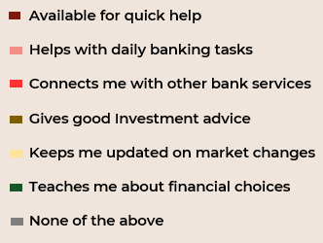
THE RELATIONSHIP MANAGER
CUSTODIAN OR facilitator?
58% respondents see RM as someone who primarily assists with “regular” banking
THE RM’S ROLE
59
TERRAGNI CONSULTING (P) LTD PRIVATE AND CONFIDENTIAL
n= 165

Slide 60
THE RELATIONSHIP MANAGER
CUSTODIAN OR facilitator?
THE RM’S ROLE – ACROSS BRANDS
60
TERRAGNI CONSULTING (P) LTD PRIVATE AND CONFIDENTIAL
N=622
Notes:
RM role for all brand wise

Slide 61
THE RELATIONSHIP MANAGER
CUSTODIAN OR facilitator?
Expectation experience gap
“RM doesn't have any role on this one. This is my understanding because the RM was saying that it is already been processed by them”
CONCERNS
Customer alignment
Process knowledge
Product knowledge
Male, 40-50
“I checked it with my RM. What is the reason behind it? He said it has to be accepted by all international airports, but I said no, they didn't accept this.”
Male, 50-65
Fundamental Attribution Error
59
TERRAGNI CONSULTING (P) LTD PRIVATE AND CONFIDENTIAL

Slide 62

The Competition
AT A GLANCE
. CELESTA . PRIVY LEAGUE . IMPERIA . BURGUNDY
62
TERRAGNI CONSULTING (P) LTD PRIVATE AND CONFIDENTIAL

Slide 63
The Affluent Customer
PRIMARY ROLE OF THE BANK
TERRAGNI CONSULTING (P) LTD PRIVATE AND CONFIDENTIAL
n= 622

Slide 64
The Affluent Customer
WEALTH ATTITUDES
Current Celesta customer base is conservative.
Unlike HDFC, AXIS, KOTAK the Celesta Customer is Affluent by “Purchasing Power Parity”
Conservatives
Balanced
Go-getters
TERRAGNI CONSULTING (P) LTD PRIVATE AND CONFIDENTIAL

Slide 65
IN A NUTSHELL
The user-friendliness of the mobile app and the in-person interactions make transacting with Federal Celesta easier.
HDFC is by far perceived as the best performer in providing premium banking & lifestyle benefits.
Nearly 100% of customers of the competitor brands have experienced Lifestyle Benefits.
ICICI is perceived to be trailing stated competition brands (HDFC, KOTAK, AXIS) in terms of providing Lifestyle Benefits Experience
Given the customer mindset similarity between ICICI Wealth and Federal Celesta, Federal is likely to succeed better with ICICI customer.
65
TERRAGNI CONSULTING (P) LTD PRIVATE AND CONFIDENTIAL

Slide 66







AT A GLANCE
 | CELESTA | PRIVY | IMPERIA | BURGUNDY
TRANSACTION EASE
PREMIUM BANKING - AWARENESS
PREMIUM BANKING - EXPERIENCE
LIFESTYLE BENEFITS - AWARENESS
LIFESTYLE BENEFITS - EXPERIENCE
RELATIONSHIP MANAGER
SERVICE & SUPPORT
Customers who bank only with Celesta and have no other banking relationship are happier with Celesta. However, this could be a function of expectation rationalisation
66
TERRAGNI CONSULTING (P) LTD PRIVATE AND CONFIDENTIAL

Slide 67
Key takeaways
Sense Making
Terragni’s multi-disciplinary insights engine
67
TERRAGNI CONSULTING (P) LTD PRIVATE AND CONFIDENTIAL

Slide 68
Key takeaways
CELESTA expectations
Help me grow my money
Help me enhance my lifestyle
Help me enjoy exclusivity
Untapped opportunities
Domestic affluent
Beyond money - Wealth
Beyond Status – Prestige
Engage “Family as a unit”
White Glove
What is not working
“Premium banking” offerings perceived to be limited and of low relevance
While the “NR” customer is functionally satisfied, experiential engagement is weak
Celesta’s Functional Ease is not strong enough a differentiator for the Domestic Affluent customer
Weak “Word-of-Mouth”
STRENGTHS
Seen as
  Safe
  High on integrity
  High on stability
‘Home brand/Family brand’ a strong emotional connect driver
Robust industry leading digital infrastructure
Good place to put in money – take out money
68
TERRAGNI CONSULTING (P) LTD PRIVATE AND CONFIDENTIAL

Slide 69
The CELESTA PROGRAM
Up Next?
69
TERRAGNI CONSULTING (P) LTD PRIVATE AND CONFIDENTIAL

Slide 70
RECOMMENDATIONS
70
TERRAGNI CONSULTING (P) LTD PRIVATE AND CONFIDENTIAL

Slide 71
The Recommendation Pillars.
STRATEGIC
EXPERIENTIAL SEGMENTS
ENGAGEMENT CUSTODIAN
THE WHITE GLOVE
FRICTIONLESS EXPERIENCES
Incorporate Experiential Segments as an integral part of Federal Bank/Celesta Segmentation strategy
Design offerings & experiences that closely match customer context and experiential expectations to stay continuously relevant
Redefine RM’s Role
Generate alignment with the customer aspirations & challenges
Making the customer feel “Prioritized” & “Differentiated”
Single point customer ownership & accountability
Design experiences across journeys and touchpoints to
Drive “Exclusivity” , “Affiliation” and “Prestige”
Leverage the power of “Engagement driven Attention” economy for Celesta
Make friction as the leading metric for engagement
Track Physical & Temporal friction as Celesta scales
Minimize Cognitive Friction through targeted process simplification
Minimize Perceived Friction through compassionate empathy and contextual communication
71
TERRAGNI CONSULTING (P) LTD PRIVATE AND CONFIDENTIAL
Notes:
Key Solution Pillars
ES
RC
WGS
SR

Slide 72
The Recommendation Pillars.
OPERATIONAL
CUSTOMER JOURNEY MAP
PROCESS BLUEPRINTING
SERVICE RECOVERY
Map key behavioural customer journeys to understand points of high “Emotion Arousal” (Peaks).
“Peaks” are opportunities for building strong & lasting customer engagement in a profitable manner!
Design and blue-print processes to support the customer journeys. This ensures that experiences are delivered as “designed”
Making the customer feel “Prioritized” & “Differentiated”
Systemic intentional preparation for failure
Designed to convey assurance - when things go wrong
Designed to ensure customer faces the least stress & impact
72
TERRAGNI CONSULTING (P) LTD PRIVATE AND CONFIDENTIAL
Notes:
Key Solution Pillars
ES
RC
WGS
SR

Slide 73
Experiential Segmentation
The breakthrough outside-in perspective
Segmenting customers on their experiential needs
70
TERRAGNI CONSULTING (P) LTD PRIVATE AND CONFIDENTIAL

Slide 74


Recommended EXPERIENTIAL SEGMENTS
PRAVASI PIONEERS
ANCHOR ALLIANCE
SEGMENT PROFILE IDENTIFIERS
SEGMENT PROFILE IDENTIFIERS
---
Primary Segment
45+ years of age from the southern part of India & is Non-Resident Indian
CURRENT STRONGHOLD
Adjacent Segment
30-45-year-olds, Indians, who are relatives /spouses/children/friends of the "Pravasi Pioneers“
LOW-HANGING ADJACENCY
---
Primary desired emotion
Assurance and faith
Primary desired emotion
Convenience and priority
74
TERRAGNI CONSULTING (P) LTD PRIVATE AND CONFIDENTIAL
Notes:
"Pravasi" is instantly recognizable to the target segment, as it's commonly used in Malayalam and official Indian government communications (like Pravasi Bharatiya Divas)2. "Pioneers" gives them the respect they deserve as the first generation that really established the India-Gulf connection and built successful careers there3. The alliteration makes it memorable4. It has positive connotations - acknowledging their role as pathfinders who paved the way for future generations of Indian professionals in the Gulf
"Anchor Alliance" works really well! Here's why it's particularly fitting:
"Anchor" suggests:
Stability (they're often the stable connection between India and Gulf)
Reliability (they handle responsibilities for the Pravasi Pioneers)
Grounding (they keep family ties strong)
"Alliance" captures:
The network aspect (family, friends, business connections)
Collaborative nature of their relationships
Formal and informal support systems
Together, "Anchor Alliance" and "Pravasi Pioneers" make a strong, complementary pair of segment names that tell a story about the interconnected nature of these two groups.
Examples – Contextualised White Glove Service

Slide 75

ELITE SYNERGY
SEGMENT PROFILE IDENTIFIERS
Recommended EXPERIENTIAL SEGMENTS
Target Customer Base
Age 40yrs & above
Seek the agility, speed & energy of modern Private banks like an HDFC or KOTAK OR DBS but also seek the “perceived” assurance, confidence, robustness & solidity of banks like State Bank of India, ICICI
Seek the sense of control & empowerment associated with digital touchpoints but also would seek the assurance & ownership that comes with contextual financial & wealth management advice coming from an investment expert.
---
Primary desired emotion
Assurance and faith
Aspirational Focus
Prestige and exclusivity
75
TERRAGNI CONSULTING (P) LTD PRIVATE AND CONFIDENTIAL
Notes:
"Pravasi" is instantly recognizable to the target segment, as it's commonly used in Malayalam and official Indian government communications (like Pravasi Bharatiya Divas)2. "Pioneers" gives them the respect they deserve as the first generation that really established the India-Gulf connection and built successful careers there3. The alliteration makes it memorable4. It has positive connotations - acknowledging their role as pathfinders who paved the way for future generations of Indian professionals in the Gulf
"Anchor Alliance" works really well! Here's why it's particularly fitting:
"Anchor" suggests:
Stability (they're often the stable connection between India and Gulf)
Reliability (they handle responsibilities for the Pravasi Pioneers)
Grounding (they keep family ties strong)
"Alliance" captures:
The network aspect (family, friends, business connections)
Collaborative nature of their relationships
Formal and informal support systems
Together, "Anchor Alliance" and "Pravasi Pioneers" make a strong, complementary pair of segment names that tell a story about the interconnected nature of these two groups.
Examples – Contextualised White Glove Service

Slide 76

RM AS THE engagement CUSTODIAN
EXPERTISE
CUSTOMER ENGAGEMENT
TRANSACTION FACILITATION
Wealth & investment planning
Family banking
Resolution expertise
Industry domain
Connect may be remote, periodic, need & context driven
Rapport building
Updates – transaction specific as well as about customers’ area of interest
Program utilization nudges
“Ownership & stress transference”
Conversations
In-person connect, frequently by RM, periodically by
“Senior Person”
Digital first
“My Celesta”
Seamless digital-physical handshake
Proactive reliable systems
Personalization
TERRAGNI CONSULTING (P) LTD PRIVATE AND CONFIDENTIAL

Slide 77
A new tier suggestion
Imperio++ : A steppingstone to Celesta
In the context of the domestic market, the current qualifying criteria of Celesta often mean that a typical potential prospect is in a higher age demographic.
This increases the probability of prospect being aware/familiar/ or already engaged with a competition.
This impacts NTB acquisition at Celesta Level
An intermediate premium tier with a lower qualifying criteria than Celesta can help attract the younger demographic (30-40) which can then be subsequently upgraded to Celesta criteria , through active engagement
Additionally, the wide gap between Imperio & Celesta leads ETB Imperio customers to perceive Celesta to be a distant aspiration
An intermediate level will make give a “step-wise” progressive perception to meeting Celesta eligibility
77
TERRAGNI CONSULTING (P) LTD PRIVATE AND CONFIDENTIAL
Notes:
"Pravasi" is instantly recognizable to the target segment, as it's commonly used in Malayalam and official Indian government communications (like Pravasi Bharatiya Divas)2. "Pioneers" gives them the respect they deserve as the first generation that really established the India-Gulf connection and built successful careers there3. The alliteration makes it memorable4. It has positive connotations - acknowledging their role as pathfinders who paved the way for future generations of Indian professionals in the Gulf
"Anchor Alliance" works really well! Here's why it's particularly fitting:
"Anchor" suggests:
Stability (they're often the stable connection between India and Gulf)
Reliability (they handle responsibilities for the Pravasi Pioneers)
Grounding (they keep family ties strong)
"Alliance" captures:
The network aspect (family, friends, business connections)
Collaborative nature of their relationships
Formal and informal support systems
Together, "Anchor Alliance" and "Pravasi Pioneers" make a strong, complementary pair of segment names that tell a story about the interconnected nature of these two groups.
Examples – Contextualised White Glove Service

Slide 78

CONSTRUCTING THE CONTEXTUAL ALIGNMENT
SOME EXAMPLES
A (Digi)concierge program that continually aligns to customers’ functional & emotional context & experiential expectations
The White Glove
TERRAGNI CONSULTING (P) LTD PRIVATE AND CONFIDENTIAL

Slide 79

THE WHITE GLOVE
“I planned an exquisite getaway in Cambodia…
Except when I landed,
I realized I forgot to research about where could I enjoy the best local specialty–
Palm Wine…”
--- I called My Celesta Concierge---
Influencer driven curated Destination Services-travel, cuisine, culture, wellness
Celesta certified premium social media influencers community that Celesta Customers can tap into for verified curated content & recommendations on experiencing destinations that they travel to.
TERRAGNI CONSULTING (P) LTD PRIVATE AND CONFIDENTIAL
TERRAGNI CONSULTING (P) LTD PRIVATE AND CONFIDENTIAL
Notes:
Four slides
Content more for eachKotak certified premium influencers community that Privy League can tap into for verified curated content & recommendations
– “Perceived Friction”

Slide 80

THE WHITE GLOVE
“I don’t much watch movies…
What do I do with these movie tickets…
I wish I could get something more relevant instead… like a tea-box subscription perhaps..”
---Let me set this up on My Celesta---
My Celesta Program –
“Configured Benefits”
An exclusive interface that allows the customer “configure” how they would like to use the “The Celesta DigiConcierge” – A way to enhance onboarding engagement.
An opportunity for the “Custodian” team to build rapport with the customer. A means for the brand to continuously be aligned with customers’ interests.

Slide 81
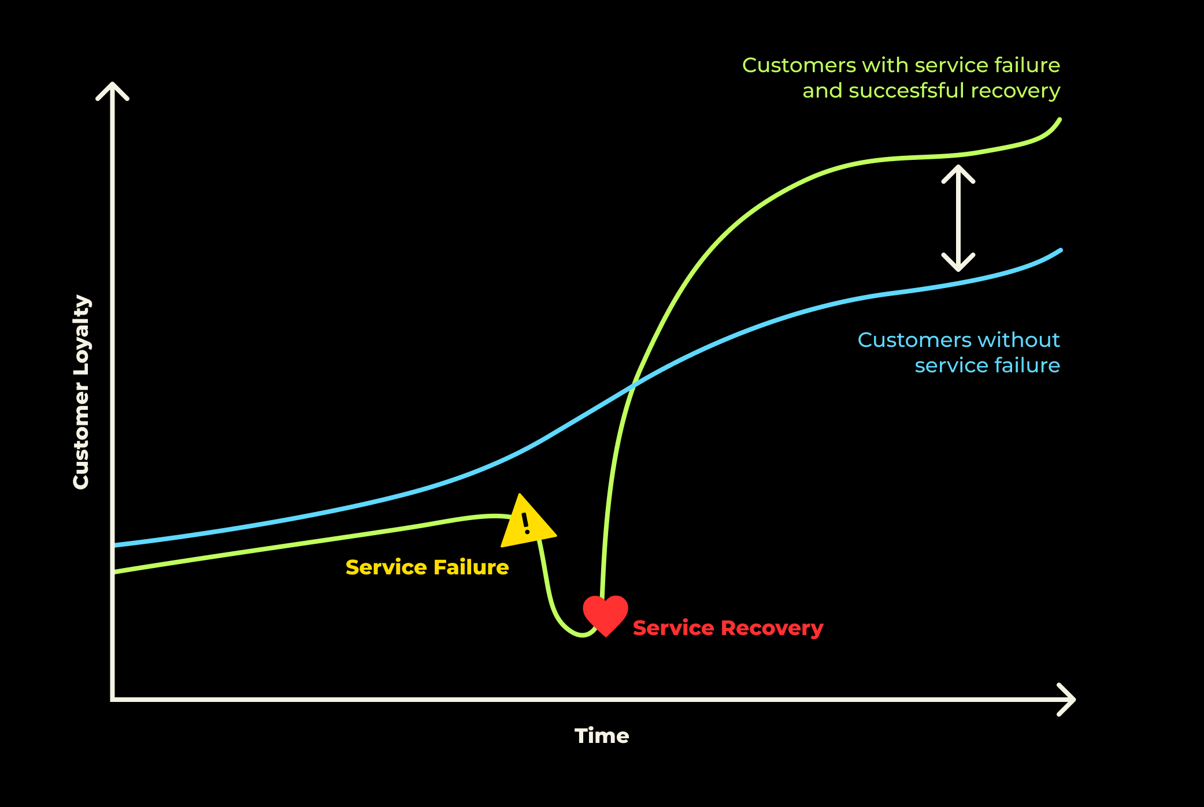
SERVICE RECOVERY – PLANNING FOR FAILURE
Even the best laid processes & journeys fail.
What matters is recovering in manner that
  Minimizes impact on customer engagement
  Drives positive word-of-mouth
  Does not cause the brand to loose money
The key to service recovery is to focus on moments of high emotional arousal (Peaks) and guarding against negative biases that could set in
A structured, systematic and empowered approach
to post-facto address customer fulfilment process failures & stress points to prevent subsequent & future engagement breakdown
TERRAGNI CONSULTING (P) LTD PRIVATE AND CONFIDENTIAL
Notes:
Even the best laid processes and journeys will fail
Not to looase cistome
Positive word of mouth
Not loose monet
Focusing on points of emotional arousal

Slide 82
SERVICE RECOVERY
IMMEDIATE RESPONSE
SHORT TERM RESPONSE
PROCESS SHIFTS
Ownership & Stress transference
Escalation matrix – visible, available & informed
No questions asked redressal
Transparency
Precision
Clarity
Best resolution to address functional impact and outcome
Proactive updates
Time bound
System changes
Process alignments
People orientation
Biases to guard against - Cognitive Dissonance, Fundamental Attribution Error, Forked Tail Effect
82
TERRAGNI CONSULTING (P) LTD PRIVATE AND CONFIDENTIAL

Slide 83
The Marketing Aircover
SCARF: To bridge the perceived friction led deficit & drive decision velocity
Identifies social factors that influence human behaviour. These factors drive our responses to situations, promoting either a threat or a reward response. The model emphasizes that meeting these needs can positively impact motivation
Status | Certainty | Autonomy | Relatedness | Fairness
Perceived Social Standing Wealth clients are highly sensitive to their perceived status. Exclusive access, VIP recognition, and personalized attention elevate their sense of importance. | Reducing Ambiguity & Risk Premium clients value predictability in market fluctuations, investment returns, and financial planning. | Sense of Control Clients prefer control over their financial choices while valuing expert guidance. | Sense of Belonging & Trust Relationship-driven banking thrives on trust and personal connections. | Perceived Equity & Transparency Premium banking clients demand transparency and equitable treatment across wealth tiers.
Nudge Example: “Exclusive Events: Private investment dinners, networking with ultra-high-net-worth (UHNW) individuals.” | Nudge Example: Preemptive Market Insights: Provide proactive alerts on market movements with clear action steps. Personalized Wealth Roadmaps: AI-driven future scenario simulations. | Nudge Example: Guided Yet Flexible: Offer AI-based recommendations with an “override” option. Empowerment Messaging: “Your wealth, your decisions—powered by expert insights.” | Nudge Example : Private Community Building: Exclusive investment clubs, curated peer events. Warm Onboarding Rituals: Personalized welcome kits, hand-written notes. | Nudge Example : Loyalty-Based Benefits: Rewarding longevity with incremental privileges. Fair Access to Opportunities: Ensure all elite clients get equal early access to lucrative investments.
TERRAGNI CONSULTING (P) LTD PRIVATE AND CONFIDENTIAL

Slide 84
The Marketing Aircover
STEPPS: To drive virality of the Federal Premium Banking platform
Social Currency | Triggers | Emotion | Public | Practical | Stories
1. Social Currency: make people feel special or in-the-know encourages sharing, as it enhances their social status.
2. Triggers: Specific cues or reminders for top-of-mind recall, prompting discussions and shares.
3. Emotion: evoke strong emotional responses—whether positive or negative.
4. Public: Visibility matters; easily observable and seen
5. Practical Value: Useful and informative , provides practical benefits.
6. Stories: Narratives that engage & are easy to remember enhance shareability
TERRAGNI CONSULTING (P) LTD PRIVATE AND CONFIDENTIAL

Slide 85
The Marketing Aircover
STEPPS: why people share and engage, which is crucial for referral-driven / WoM
Social Currency | Triggers | Emotion | Public | Practical | Stories
Signals of Prestige Premium banking should feel like a status symbol—something clients want to “show off.” | Top-of-Mind Awareness Clients should be regularly reminded of the bank’s value in their everyday life. | High Emotional Impact Clients act when they feel an emotional connection to their wealth journey. | Visibility & Social Proof The bank’s elite positioning should be visible in social and professional circles | Useful & Actionable Clients should feel they are getting tangible, time-sensitive value. | Narrative-Driven Influence People remember stories more than stats. Banking should be a compelling narrative.
Nudge Example: Insider Investment Access: Early or exclusive entry to high-yield assets. Social Signal-Driven Invitations: “Only 500 clients globally get access to this investment.” | Nudge Example: Financial Wellness Nudges: Automated messages like “Your investment has outperformed by 3% this quarter.” Cultural Relevance: Linking offers to seasonal themes (e.g., “Diwali/Onam Wealth Unlock” or “New Year Portfolio Rebalancing”). | Nudge Example: Legacy & Purpose Messaging: Framing investments around generational wealth and philanthropy. Narrative-Based Investing: “This fund supports green energy innovations—invest with impact.” | Nudge Example: Client Spotlights (Anonymous but Aspirational): “Meet a client who turned a 20 lakh portfolio into 1 Crore.” | Nudge Example: Concise Market Insights: 60-second wealth briefings tailored to their portfolio. Actionable Strategies: “Top 3 investments to hedge against inflation in 2025.” | Nudge Example: Heritage Banking Tales: “How we’ve helped families preserve their legacy for generations.” Gamified Wealth Planning: “Choose your investment adventure” interactive stories.
TERRAGNI CONSULTING (P) LTD PRIVATE AND CONFIDENTIAL

Slide 86
Uniquely Different
IMPLEMENTATION ROADMAP
The Behaviour Shift.
90 days
120 days
120 days+
86
TERRAGNI CONSULTING (P) LTD PRIVATE AND CONFIDENTIAL
Notes:
Context is key,
Example – A young entrepreneur vs. youngster second gen managing family business – Could be the same business, same RV; but their decision making & approach to finances will be different
Consequently the experiences they seek will be different
Autonomy in decision making, decision influencers, experiences – own as well as observed will all impact how they approach finance an

Slide 87
90 days
 | EXPERIENTIAL SEGMENTS | ENGAGEMENT CUSTODIAN | THE WHITE GLOVE | SERVICE RECOVERY
30 days | Preliminary classification – Persona based | Design & implement awareness building program of relevant benefits across tiers | Prioritizing “White Glove” areas | Analysis of chronic issues – systemic resolution - product/offering redesign; communication process
60 days | Operational fixes guided by the Experience Grids Friction as a KPI | RM Orientation Program – to align with segments & their context Experience Orientation program for cross-functional team | Identifying alliances and partnerships | Escalation matrix – Create, publish, popularize & demonstrate
90 days | Mapping key customer journeys , Identifying segment-wise differential engagement points for each key journey | Systemic insights program for utilization levels | Designing differentiated communication & messaging based on segments & utilization insights SCARF + STEPPS MODELS | First friction assessment roll-out for key service recovery journeys based on insights from past service & support data
87
© TERRAGNI CONSULTING (P) LTD PRIVATE AND CONFIDENTIAL

Slide 88
90-120 days
 | EXPERIENTIAL SEGMENTS | ENGAGEMENT CUSTODIAN | THE WHITE GLOVE | SERVICE RECOVERY
90+ days | Identifying segment wise “Peaks” & “Ends” for critical journeys Offering design : Imperio+ Tier “My Celesta” APP | Designing the “EXPERTISE” centre – structure, people, processes Establishing “EXPERTISE” centre | Implementing differentiated & contextualized program Program Build Launch Plan | Blueprinting segment-wise behaviour service recovery process
120 + days | Designing & implementing journeys | Aligning communication and delivery to experiential segments SCARF MODEL | Launch & Roll-out Program to propagate “White Glove Stories” STEPPS MODEL
88
© TERRAGNI CONSULTING (P) LTD PRIVATE AND CONFIDENTIAL

Slide 89

ANNEXURES
ADDITIONAL DETAILS
89
TERRAGNI CONSULTING (P) LTD PRIVATE AND CONFIDENTIAL

Slide 90

IMPLICIT ASSOCIATIONS
EMOTIONS AND UNSTATED PERCEPTIONS, PREFERENCES THAT DRIVE BEHAVIOUR

Slide 91
91
EMOTIONAL VALENCE
Emotions that drive premium banking engagement – THE GOAL
POSITIVE VALENCE
Emotional associations exhibited by customers with a strong affinity to their Premium Banking Programs
Strong
Moderate
Weak
Life Goals Enabler
Exclusive
Prestige
Personalized
Assurance
Innovative
Relevant
Confidence
Financial Growth
Convenience
NEGATIVE VALENCE
Strong
KEY
Strong Positive
Moderate Positive
Weak Positive
No Association
Weak Negative
Moderate Negative
Strong Negative
Intrusive
Stressful
TERRAGNI CONSULTING (P) LTD PRIVATE AND CONFIDENTIAL
Notes:
Long standing history & the personal connect drive a strong sense of Assurance
“Relative” affluence drives a sense of prestige
Digital forwardness of touchpoints & process drives a perception of Innovation & also builds higher relevance for the current customer
Perceived lack of alignment with customers’ contexts , high perceived & cognitive friction of engaging with “wealth management” and lifestyle benefits drives the weak associations with “Exclusivity”, “confidence”

Slide 92
92
EMOTIONAL VALENCE
Emotions that drive engagement for CELESTA TODAY
Emotional associations exhibited by current Celesta customers
The goal
CELESTA
Customers see “Prestige”, “Assurance”, “Innovative” & “Relevant” as the defining attributes for Celesta. Similarly, it is also not seen as “Stressful”.
However, customers do not see Exclusivity, Financial growth, Convenience as strong attributes for Celesta.
As a result, they do not perceive Celesta to be playing a role in their “Life Goals”.
This combined with a negative association with personalization also leads the customers to perceive Celesta as moderately “Intrusive”
Life Goals Enabler
Exclusive
Prestige
Personalized
Assurance
Innovative
Relevant
Confidence
Financial Growth
Convenience
Intrusive
Stressful
Life Goals Enabler
Exclusive
Prestige
Personalized
Assurance
Innovative
Relevant
Confidence
Financial Growth
Convenience
Intrusive
Stressful
KEY
Strong Positive
Moderate Positive
Weak Positive
No Association
Weak Negative
Moderate Negative
Strong Negative
CONCERN AREA
STRENGTH AREA
n= 165
TERRAGNI CONSULTING (P) LTD PRIVATE AND CONFIDENTIAL
Notes:
Put a brain
Long standing history & the personal connect drive a strong sense of Assurance
“Relative” affluence drives a sense of prestige
Digital forwardness of touchpoints & process drives a perception of Innovation & also builds higher relevance for the current customer
Perceived lack of alignment with customers’ contexts , high perceived & cognitive friction of engaging with “wealth management” and lifestyle benefits drives the weak associations with “Exclusivity”, “confidence”

Slide 93
Contextual alignment is an opportunity area
93
HELP ME GROW MY MONEY
CONTEXTUAL . CONSISTENT . TRANSPARENT
Salience of premium banking services
Investment wealth advisory
Reduced transaction fees
Foreign exchange
Taxation advisory and services
Current account servicing
Doorstep banking
Multi currency card
Most Salient Features
Reduced transaction fees
Investment wealth advisory
Taxation Advisory & Services
Non-Salient Features
Current account servicing
Doorstep banking
Foreign Exchange
Strong Positive | Moderate Positive | Weak Positive | No association
Strong Negative | Moderate Negative | Weak Negative
KEY
TERRAGNI CONSULTING (P) LTD PRIVATE AND CONFIDENTIAL
n= 165

Slide 94
Personalization is an opportunity area
ENHANCE MY LIFESTYLE
PERSONALIZED CONVENIENCE. PERSONALIZED PRESTIGE
Salience of Lifestyle benefits
Exclusive digital content
Exclusive events
Personalized luxury experiences
Philanthropy
Concierge services
Multi currency card
Most Salient Features
Personalized luxury
Exclusive events
Non-Salient Features
Concierge
Philanthropy
Exclusive digital content
Strong Positive | Moderate Positive | Weak Positive | No association
Strong Negative | Moderate Negative | Weak Negative
KEY
94
TERRAGNI CONSULTING (P) LTD PRIVATE AND CONFIDENTIAL
n= 165

Slide 95
The Competition
SPECIFICS
. CELESTA . PRIVY LEAGUE . IMPERIA . BURGUNDY
95
TERRAGNI CONSULTING (P) LTD PRIVATE AND CONFIDENTIAL

Slide 96
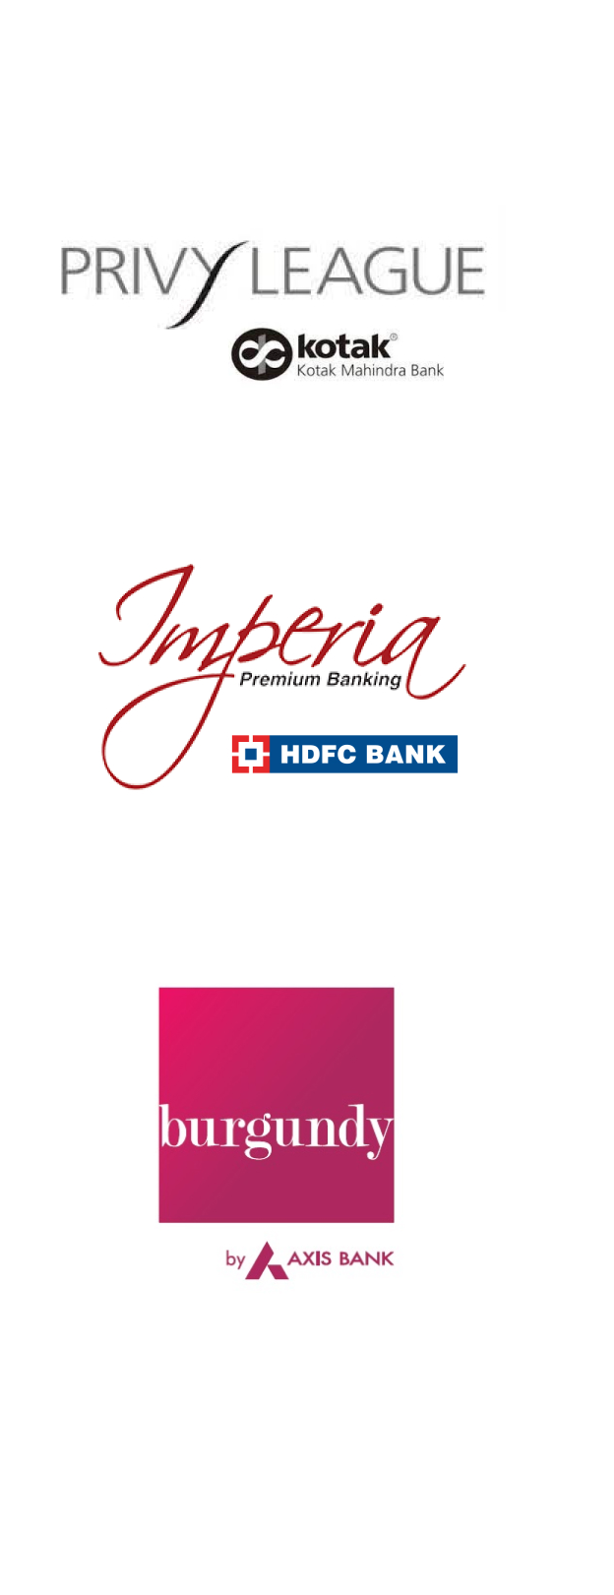




TRANSACTION EASE
PREMIUM BANKING
LIFESTYLE BENEFITS
THE RM
SUPPORT & SERVICE
Exclusively CELESTA customers
CELESTA + imperia customers
CELESTA + burgundy customers
CELESTA + Privy customers
96
TERRAGNI CONSULTING (P) LTD PRIVATE AND CONFIDENTIAL

Slide 97
TRANSACTION EASE
Exclusively CELESTA customers
CELESTA + imperia customers
CELESTA + burgundy customers
CELESTA + Privy customers
97
TERRAGNI CONSULTING (P) LTD PRIVATE AND CONFIDENTIAL

Slide 98
only
CELESTA
CELESTA +PRIVY
Federal is perceived to provide higher transaction ease than HDFC, Axis, Kotak
Federal mobile app is also perceived to be easier to use than HDFC , Axis & Kotak
CELESTA + IMPERIA
CELESTA + BURGUNDY
98
n= 165
TERRAGNI CONSULTING (P) LTD PRIVATE AND CONFIDENTIAL
Notes:
Federal Customer + Federal competitors data=165

Slide 99
BURGUNDY
PRIVY
An average ~30% of competition customers are dissatisfied with their primary bank on “Transaction experience”
IMPERIA
ICICI
99
n= 622
TERRAGNI CONSULTING (P) LTD PRIVATE AND CONFIDENTIAL
Notes:
Add the one line descriptions from Hrishikesh’s file

Slide 100
PREMIUM BANKING
Exclusively CELESTA customers
CELESTA + imperia customers
CELESTA + burgundy customers
CELESTA + Privy customers
100
TERRAGNI CONSULTING (P) LTD PRIVATE AND CONFIDENTIAL

Slide 101
only
CELESTA
CELESTA+PRIVY
Customers have familiarity with competition premium banking offerings rate Celesta lower than those who don’t
CELESTA + IMPERIA
CELESTA + BURGUNDY
101
n= 165
TERRAGNI CONSULTING (P) LTD PRIVATE AND CONFIDENTIAL
Notes:
Remove “Account Statements & Reports” from this graph

Slide 102
PRIVY
BURGUNDY
HDFC leads the pack .
ICICI and Axis trail the others
IMPERIA
ICICI
102
n= 622
TERRAGNI CONSULTING (P) LTD PRIVATE AND CONFIDENTIAL
Notes:
Remove Account statement and reports from here

Slide 103
LIFESTYLE BENEFITS
Exclusively CELESTA customers
CELESTA + imperia customers
CELESTA + burgundy customers
CELESTA + Privy customers
103
TERRAGNI CONSULTING (P) LTD PRIVATE AND CONFIDENTIAL

Slide 104
only
CELESTA
CELESTA+ PRIVY
Among those who have experienced Lifestyle Benefits, HDFC is rated the best.
Celesta + Privy customers feel they have not received any Lifestyle benefits from Celesta.
CELESTA + IMPERIA
CELESTA + BURGUNDY
104
n= 165
TERRAGNI CONSULTING (P) LTD PRIVATE AND CONFIDENTIAL
Notes:
Add the one line descriptions from Hrishikesh’s file

Slide 105
PRIVY
BURGUNDY
Unlike Federal, nearly 100% of customers from the other brands have experienced Lifestyle Benefits.
ICICI trails the group in providing lifestyle benefits
IMPERIA
ICICI
105
n= 622
TERRAGNI CONSULTING (P) LTD PRIVATE AND CONFIDENTIAL
Notes:
Add the one line descriptions from Hrishikesh’s file

Slide 106
THE RM
Exclusively CELESTA customers
CELESTA + imperia customers
CELESTA + burgundy customers
CELESTA + Privy customers
106
TERRAGNI CONSULTING (P) LTD PRIVATE AND CONFIDENTIAL

Slide 107
ONLY CELESTA
CELESTA + PRIVY
The performance of RMs from Federal is better than any other brand.
RMs are the highlight of the Celesta program.
CELESTA + IMPERIA
CELESTA + BURGUNDY
107
n= 165
TERRAGNI CONSULTING (P) LTD PRIVATE AND CONFIDENTIAL
Notes:
Add the one line descriptions from Hrishikesh’s file

Slide 108
PRIVY
Satisfaction levels with Relationship Manager performance are significantly higher among Federal customers compared to customers of other brands.
BURGUNDY
IMPERIA
ICICI
108
n= 622
TERRAGNI CONSULTING (P) LTD PRIVATE AND CONFIDENTIAL
Notes:
Add the one line descriptions from Hrishikesh’s file

Slide 109
SUPPORT & SERVICE
Exclusively CELESTA customers
CELESTA + imperia customers
CELESTA + burgundy customers
CELESTA + Privy customers
109
TERRAGNI CONSULTING (P) LTD PRIVATE AND CONFIDENTIAL

Slide 110
ONLY CELESTA
CELESTA + PRIVY
Celesta provides the best support and service among all the brands., where as Privy is rated the lowest in this regard.
CELESTA + IMPERIA
CELESTA + BURGUNDY
110
n= 165
TERRAGNI CONSULTING (P) LTD PRIVATE AND CONFIDENTIAL
Notes:
Add the one line descriptions from Hrishikesh’s file

Slide 111
PRIVY
BURGUNDY
Federal leads with 81% of its customers rating the bank as supportive,
ICICI trails the set with only 50% of its customers finding the bank’s support helpful.
IMPERIA
ICICI
111
n= 622
TERRAGNI CONSULTING (P) LTD PRIVATE AND CONFIDENTIAL
Notes:
Add the one line descriptions from Hrishikesh’s file

Slide 112
dipti@terragni.in
www.terragni.in
+91 823 702 5269
+91 202 588 5776
Thank You
TERRAGNI CONSULTING (P) LTD PRIVATE AND CONFIDENTIAL

